Slide 1
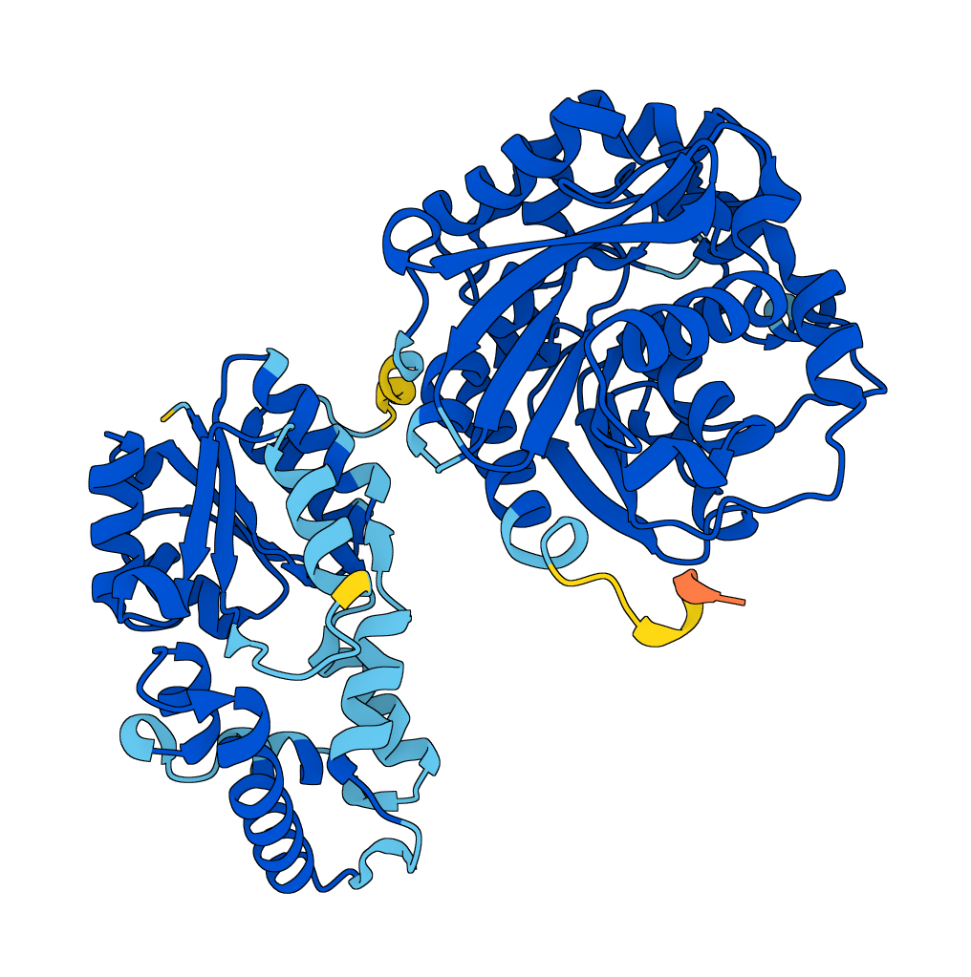

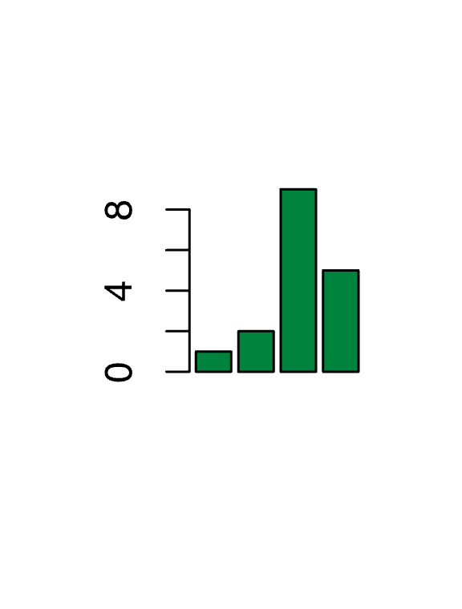

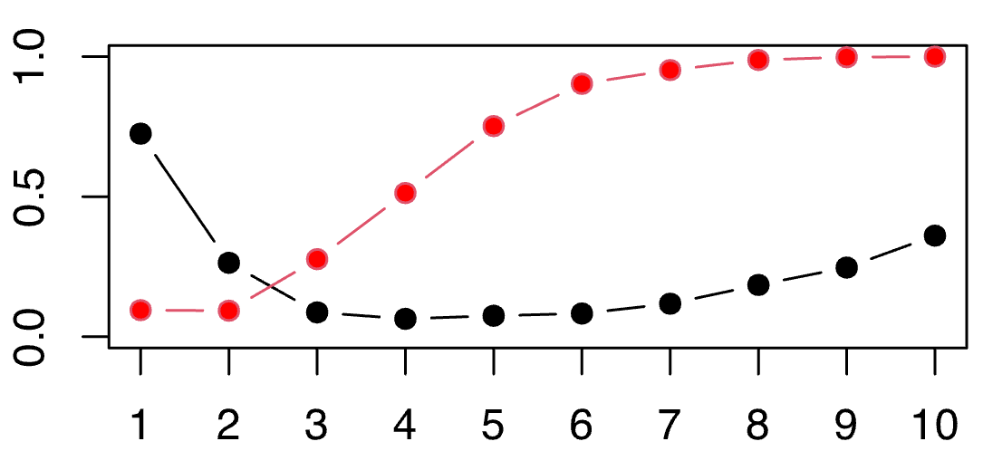
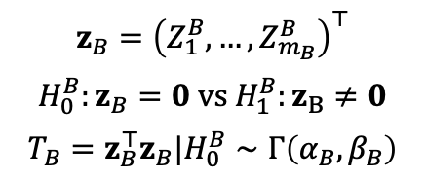
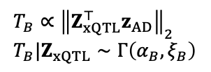
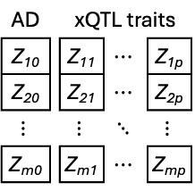
Set-based association testing integrating xQTLs improves druggable gene discovery in Alzheimer’s disease
Noah Lorincz-Comi & Feixiong Cheng (U01AG073323)
Genomic Medicine Institute, Cleveland Clinic Foundation
October 15th, 2024
SNP set association testing (GenT)
Integrating xQTLs (xGenT)
xGenT uses xQTL weights
Integrating xQTLs can improve power
I: Causal SNP
SNP set C
Protein abundance
Disease status
SNP set B
SNP set A
pQTLs
AD |  | xQTL traits
Z₁₀ |  | Z₁₁ | $$⋯$$ | Z_{1p}
Z₂₀ |  | Z₂₁ | $$⋯$$ | Z_{2p}
$$⋮$$ |  | $$⋮$$ | $$⋱$$ | $$⋮$$
Z_{m0} |  | Z_{m1} | $$⋯$$ | Z_{mp}
Without xQTL integration
With xQTL integration
SNP set B
U
Power
Gene B
Gene B
Gene A
Gene C
eQTLs
# of causal xQTL phenotypes
Gene expression
$$T_{B}∝{\left\|Z_{xQTL}^{⊤}z_{AD}\right\|}_{2} \\ T_{B}|Z_{xQTL}∼Γ\left(α_{B},ξ_{B}\right)$$
$$z_{B}={\left(Z_{1}^{B},…,Z_{m_{B}}^{B}\right)}^{⊤}$$
$$H_{0}^{B}:z_{B}=0 vs H_{1}^{B}:z_{B}≠0$$
$$T_{B}=z_{B}^{⊤}z_{B}|H_{0}^{B}∼Γ\left(α_{B},β_{B}\right)$$
Multiple finemaps in SYK locus improves detection of AD association
SYK
GenT FDR=8E-5
RIPK2
xGenT FDR=2E-10
Improved power from polygenicity
Lead SNP-based gene inference
SNP set-based gene inference
Power to detect
gene association
Number of causal SNPs in set (fixed h²)
Notes:
################################################################################
# GenT simulation plot
################################################################################
rm(list=ls(all=TRUE))
library(mvnfast)
source('/Volumes/chengflab/Cheng-Noah/software/corefunctions/functions.R')
ar1=function(n,rho) rho^toeplitz(0:(n-1))
m=100
h2=0.00075
ld=ar1(m,0.9)
th=solve(ld)
ngwas=50000
mcausal=1:10
niter=1000
RES=matrix(nr=length(mcausal),nc=2)
for(i in 1:length(mcausal)) {
b=rep(0,m)
causalix=round(seq(1,m,length.out=mcausal[i]))
b[causalix]=sqrt(h2/mcausal[i])
bhat=rmvn(niter,b,th/ngwas)
betahat=bhat%*%ld
stats=betahat^2*ngwas
# SNP-based
res1=apply(stats,1,function(h) any(h>qchisq(1-5e-8,1)))
# gene-based
res2=apply(sqrt(ngwas)*betahat,1,function(h) gent(h,ld)$pval)
# record resultws
RES[i,1]=sum(res1)/niter
RES[i,2]=sum(res2<(0.05/20000))/niter
}
matplot(RES,ylim=c(0,1),bg=c('black','red'),type='b',pch=21,lty=1,
yaxt='n',xaxt='n')
axis(side=1,at=1:10,labels=1:10)
axis(side=2,at=c(0,0.5,1),labels=c('0.0','0.5','1.0'))
################################################################################
# SYK plot
################################################################################
# rm(list=ls(all=TRUE))
library(data.table);library(dplyr);library(susieR,lib='/home/lorincn/Rpkgs')
###############
pop='EUR'
gene=SYK'
# gwasfp='/home/lorincn/beegfs/lorincn/data/phenotype/T2D/1kgSNPs_Suzuki_EUR_Metal_LDSC-CORR_Neff.v2.txt.gz'
gwasfp='/home/lorincn/beegfs/lorincn/data/phenotype/AD/AD_Bellenguez_2022N_b37.tsv.gz'
# gwasfp='/home/lorincn/beegfs/lorincn/data/phenotype/MDD/MDD_PGC_UKB.txt.gz'
# gwasfp='/home/lorincn/beegfs/lorincn/data/phenotype/PD/Kim_PD.txt.gz'
# gwasfp='/home/lorincn/beegfs/lorincn/data/phenotype/ALS/ALS_RheenenW.EUR_2021.tsv.gz'
# gwasfp='/home/lorincn/beegfs/lorincn/data/phenotype/SCZ/SCZ_PGC_EUR.tsv.gz' # SCZ
kb_window=500 # window around the gene center in which SuSiE will be performed
n=450000 # GWAS sample size (450K for AD; 807K for MDD; 611K for PD; 139K for ALS)
## T2D N's
# EUR: 752000
# AFR: 129000
# EAS: 247000
# SAS: 42000
# HIS: 73000
###############
gene.=gene
genepositions=fread('/home/lorincn/isilon/Cheng-Noah/manuscripts/druggable_genes/data/genepositions_hg19.txt')
genei=genepositions %>% filter(symbol==gene.) %>% head(.,1)
# starti=genei$start;endi=genei$end
gwas=fread(gwasfp) %>% as.data.frame() %>% filter(chr==genei$chr)
gwas=gwas %>% filter(abs(position-genei$mid)<(kb_window*1e3))
if(pop=='HIS') ldpop='AMR' else ldpop=pop
ldref=paste0('/home/lorincn/beegfs/lorincn/data/reference_panels/1kg.v3/',ldpop)
bim=fread(paste0(ldref,'.bim')) %>% filter(V1==genei$chr)
colnames(bim)[1:2]=c('chr','rsid')
gwas=gwas %>% filter(rsid %in% bim$rsid) %>% arrange(position)
dupes=gwas %>% group_by(rsid) %>% summarise(n=n()) %>% filter(n>1) %>% pull(rsid)
gwas=gwas %>% filter(!(rsid %in% dupes))
m=nrow(gwas)
gwas=left_join(gwas,bim %>% select(rsid,ea=V5),by='rsid') %>% mutate(beta=ifelse(effect_allele==ea,beta,-beta)) %>% arrange(position)
randir=paste(sample(c(letters,1:10),replace=T),collapse='')
setwd('/home/lorincn/beegfs/lorincn/working_space')
dir.create(randir)
setwd(randir)
write.table(gwas$rsid,'temp.txt',row.names=FALSE,quote=FALSE,col.names=FALSE)
system(paste0('plink --bfile ',ldref,' --r square --extract temp.txt --out temp'),intern=T)
ld=fread('temp.ld') %>% as.matrix()
ld=0.99*ld+0.01*diag(m)
res=susie_rss(z=gwas$beta/gwas$se,R=ld,n=n)
max(res$pip)
cat(gwas$rsid[res$pip>0.9],'\n')
cat('Pop: ',pop,'\nMax PIP: ',max(res$pip),'\nMax PIP SNPs: ',gwas$rsid[which.max(res$pip)],'\nPIP lead GWAS SNP: ',res$pip[which.min(gwas$pval)],'\n',sep='')
######################################
# If you want to save these data to plot manually with GGplot
setwd('~/isilon/Cheng-Noah')
out=list(susie_res=res,gwas=gwas,ld=ld)
saveRDS(out,'temp.Rds')
######################################
# LOCALLY
setwd('/Volumes/chengflab/Cheng-Noah')
data=readRDS('temp.Rds')
res=data$susie_res
gwas=data$gwas
ld=data$ld
library(dplyr);library(ggplot2);library(ggrepel)
ix=which.min(gwas$pval)
lead=gwas$rsid[ix]
lddf=data.frame(r2=c(ld[ix,])^2,rsid=gwas$rsid)
gwas=left_join(gwas,lddf,by='rsid')
gwas$pip=res$pip
ggplot(gwas,aes(position/1e6,-log10(pval),color=r2)) +
annotate('rect',xmin=93564069/1e6,xmax=93660831/1e6,ymin=-Inf,ymax=Inf,fill='gold') +
# annotate('text',x=(93564069+93660831)/2/1e6-0.07,y=7.5,label='SYK gene',angle=90) +
# annotate('text',x=93.2,y=7.5,label='P<5E-8') +
geom_point() +
scale_color_steps2(expression(r^2),
low='blue',mid='green',high='red',
breaks=(0:4)/4,midpoint=0.5) +
geom_point(aes(position/1e6,-log10(pval),color=r2),
shape=17,size=4,
data=gwas %>%
filter(pip>0.9,pval<0.01)) +
theme_bw() +
lims(y=c(0,-log10(5e-9))) +
geom_hline(yintercept=-log10(5e-8),linetype='dashed') +
theme(panel.border=element_rect(color='black',fill=NA,linewidth=1)) +
labs(x='Chromosome 9 (Mb)',y=expression('-log'[10]*'(AD GWAS P-value)')) +
geom_text_repel(aes(position/1e6,-log10(pval),label=rsid),
data=gwas %>%
filter(pip==1,pval<0.01),
color='black',
# nudge_x=.15,
# xlim=c(93.3,93.9),
# ylim=c(3,8),
box.padding=0.5,
nudge_y=1,
force=100,
segment.curvature=0.2,
segment.ncp=1,
segment.angle=-90) +
theme(legend.position='none',
legend.position.inside=c(0.85,0.7),
legend.box.background=element_rect(color="black"))
################################################################################
# RIPK2 plot
################################################################################
## Ran part of figure4plots.R for this
library(locuscomparer);library(ggpubr)
merged=readRDS('/Volumes/chengflab/Cheng-Noah/manuscripts/druggable_genes/working_space/merged_xqtl_ad_gwas_data_for_novel_gene.Rds')
ld=readRDS('/Volumes/chengflab/Cheng-Noah/manuscripts/druggable_genes/working_space/ld_xqtl_ad_gwas_data_for_novel_gene.Rds')
library(magrittr)
longdf=merged %$% data.frame(
rsid=rep(rsid,4),
position=rep(position,4),
z=c(ad_beta/ad_se,
brain_cerebellum_beta/brain_cerebellum_se,
brain_cortex_beta/brain_cortex_se,
pqtl_beta/as.numeric(pqtl_se)),
trait=rep(c('AD','Cerebellum eQTL','Cortex eQTL','Cortex pQTL'),each=nrow(merged))
) %>%
mutate(pval=pchisq(z^2,1,lower.tail=FALSE))
# assign LD with lead SNPs
ts=unique(longdf$trait)
rdf=data.frame()
for(i in 1:length(ts)) {
dati=longdf %>% filter(trait==ts[i])
lead_ix=which.max(abs(dati$z))
lddf=data.frame(rsid=merged$rsid,r2=c(ld[,lead_ix])^2)
dati=left_join(dati,lddf,by='rsid')
rdf=rbind(rdf,dati)
}
longdf=rdf;rm(rdf)
ripk2_finemaps=c('rs7815039','rs12156013','rs13254219','rs218935','rs218938','rs425721')
longdf %>%
filter((position/1e6)>90.25,(position/1e6)<91.25) %>%
ggplot(aes(position/1e6,-log10(pval),color=r2)) +
annotate('rect',xmin=90769975/1e6,xmax=90803291/1e6,ymin=-Inf,ymax=Inf,fill='gold') +
# annotate('text',x=93.2,y=7.5,label='P<5E-8') +
geom_point() +
facet_wrap(~trait,nrow=2) +
scale_color_steps2(expression(r^2),
low='blue',mid='green',high='red',
breaks=(0:4)/4,midpoint=0.5) +
theme_bw() +
# lims(y=c(0,-log10(5e-9))) +
geom_hline(yintercept=-log10(5e-8),linetype='dashed') +
theme(panel.border=element_rect(color='black',fill=NA,linewidth=1)) +
labs(x='Chromosome 8 (Mb)',y=expression('-log'[10]*'(P-value)')) +
geom_text_repel(aes(position/1e6,-log10(pval),label=rsid),
data=longdf %>%
filter(rsid %in% ripk2_finemaps,trait=='AD'),
color='black',
# nudge_x=.15,
# xlim=c(93.3,93.9),
# ylim=c(3,8),
box.padding=0.5,
nudge_y=1,
force=50,
segment.curvature=0.2,
segment.ncp=1,
segment.angle=-90) +
theme(legend.position='none',
legend.position.inside=c(0.15,0.7),
legend.box.background = element_rect(colour = "black"),
strip.background =element_rect(fill="beige")) +
scale_x_continuous(breaks=c(90.25,90.75,91.20),
labels=c(90.25,90.75,91.20))

Slide 2
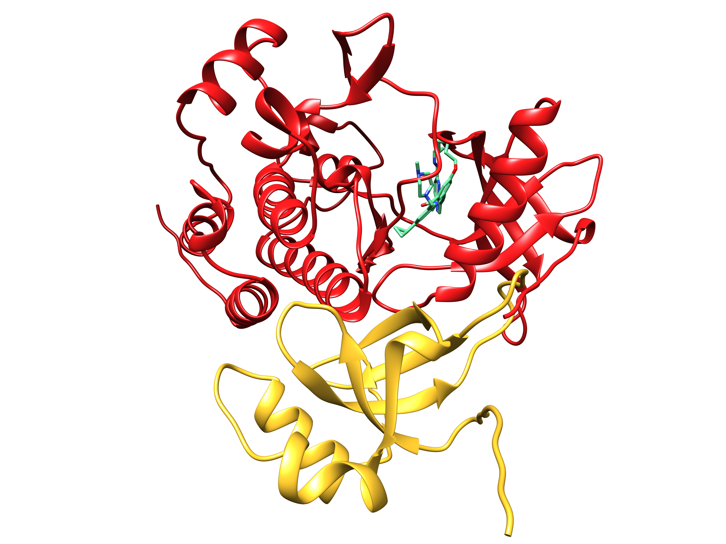
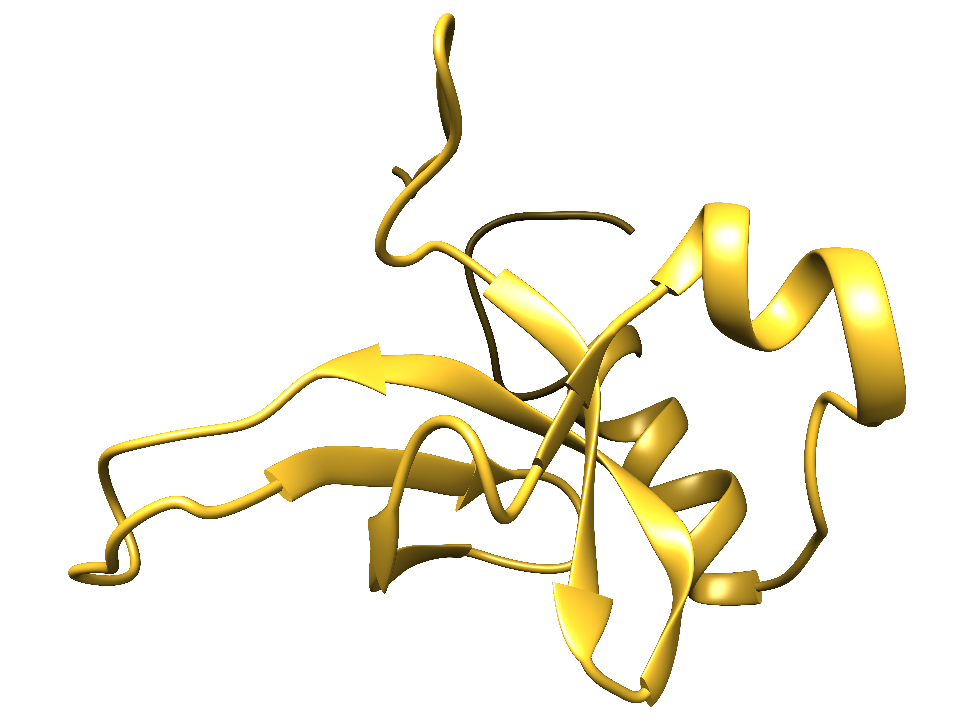
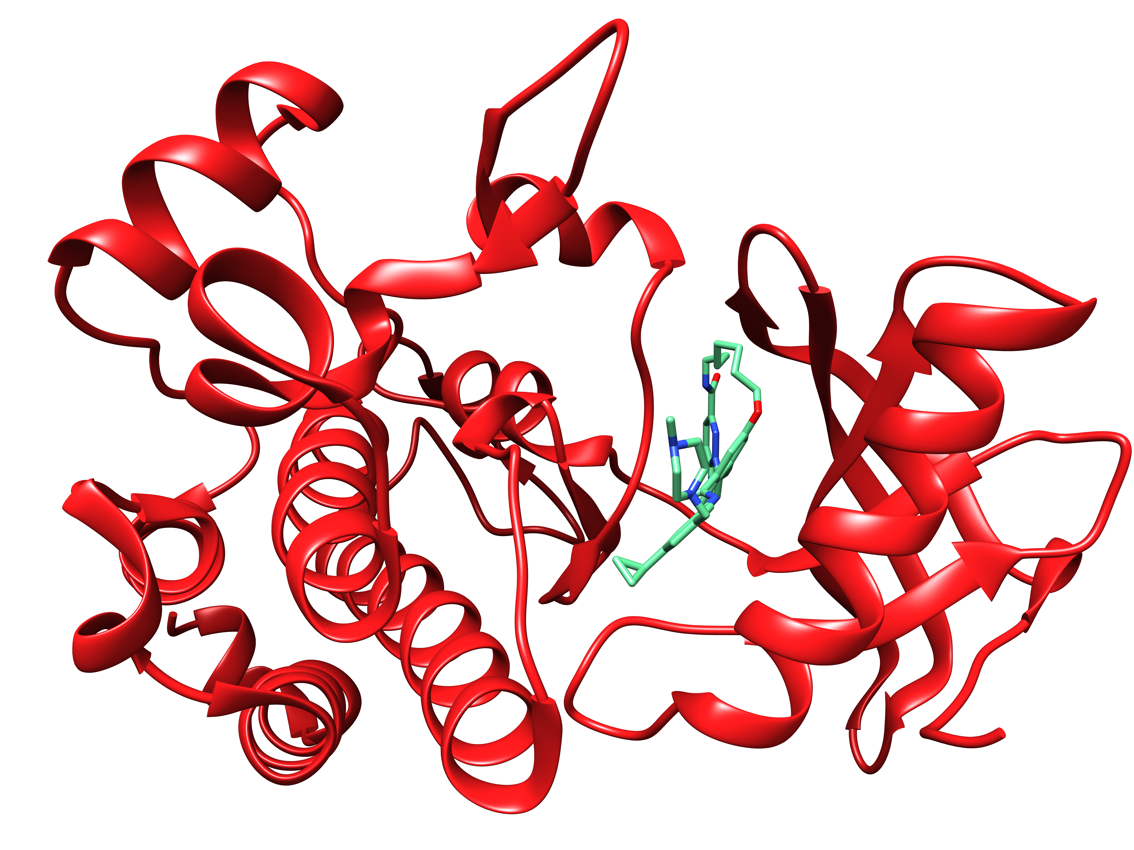


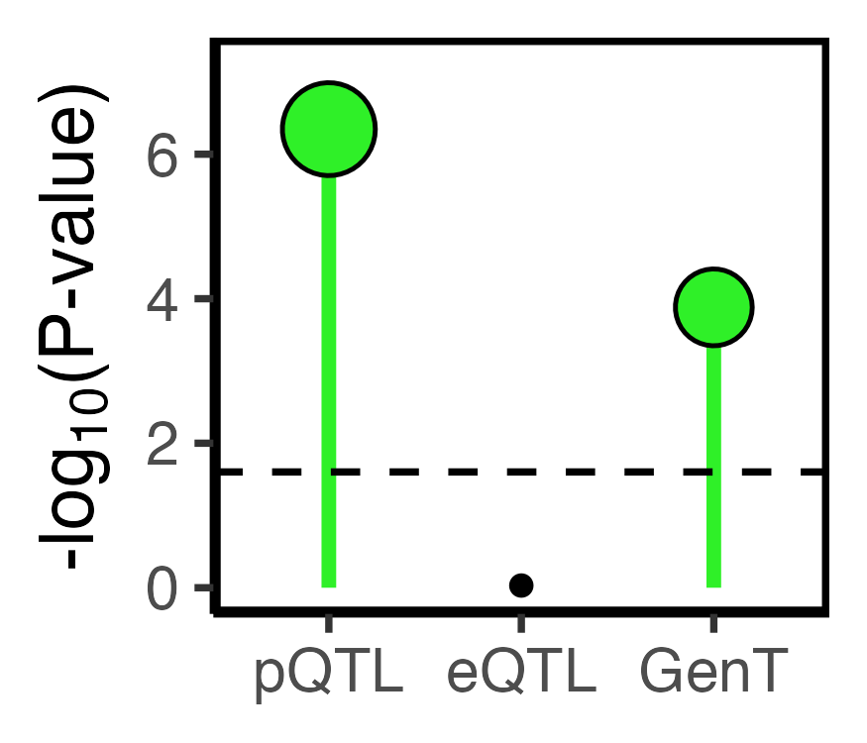
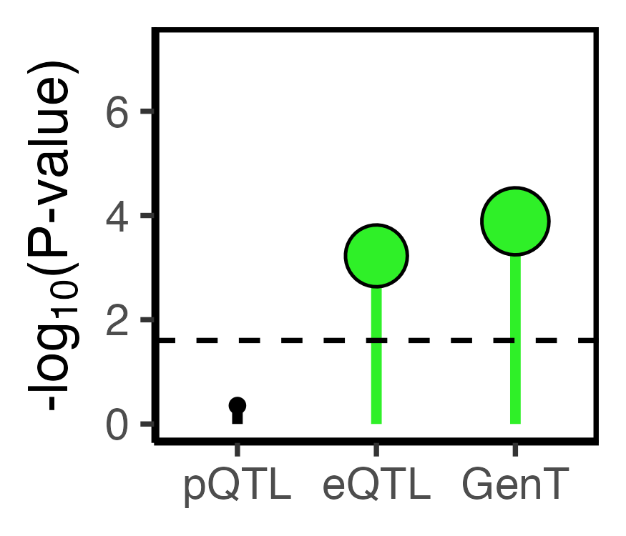
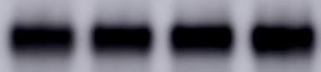
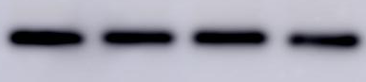
NTRK1 – novel druggable gene with experimental AD evidence
Physical protein-protein interactions with NTRK1
NTRK1
SNP → AD effect size
xGenT FDR=1E-7
Causal effect estimate
0.034 (P=2.1E-4)
AD-associated
Not AD-associated
Physical interaction
cortex eQTL effect size
NTRK1
HDGF
(druggable)
NTRK1
(druggable)
NTRK1 inhibitor (GW441756)
Patient-derived iPSCs
0μM 1μM 10μM 20μM
pTau
(Thr217)
pTau
(Thr181)
Total
tau
Beta
actin
Notes:
################################################################################
# NTRK1 plot
## Ran part of figure4plots.R for this
merged=readRDS('/Volumes/chengflab/Cheng-Noah/manuscripts/druggable_genes/working_space/merged_xqtl_ad_gwas_data_for_novel_gene.Rds')
ld=readRDS('/Volumes/chengflab/Cheng-Noah/manuscripts/druggable_genes/working_space/ld_xqtl_ad_gwas_data_for_novel_gene.Rds')
library(magrittr)
ix=which((merged$position/1e6)>156.5 & (merged$position/1e6)<157.5)
merged=merged[ix,]
ld=ld[ix,ix]
longdf=merged %$%
data.frame(
rsid=rep(rsid,4),
position=rep(position,4),
z=c(ad_beta/ad_se,
brain_spinal_cord_beta/brain_spinal_cord_se,
brain_cortex_beta/brain_cortex_se,
pqtl_beta/as.numeric(pqtl_se)),
trait=rep(c('AD','Spinal cord eQTL','Cortex eQTL','Cortex pQTL'),each=nrow(merged))
) %>%
mutate(pval=pchisq(z^2,1,lower.tail=FALSE))
# assign LD with lead SNPs
ts=unique(longdf$trait)
rdf=data.frame()
for(i in 1:length(ts)) {
dati=longdf %>% filter(trait==ts[i])
lead_ix=which.max(abs(dati$z))
lddf=data.frame(rsid=merged$rsid,r2=c(ld[,lead_ix])^2)
dati=left_join(dati,lddf,by='rsid')
rdf=rbind(rdf,dati)
}
longdf=rdf;rm(rdf)
ntrk1_finemaps=c('rs61816272','rs3765787','rs1758186','rs928392','rs10157555')
longdf %>%
na.omit() %>%
ggplot(aes(position/1e6,-log10(pval),color=r2)) +
annotate('rect',xmin=156785432/1e6,xmax=156851642/1e6,ymin=-Inf,ymax=Inf,fill='gold') +
geom_point() +
facet_wrap(~trait,nrow=4,scales='free_x') +
scale_color_steps2(expression(r^2),
low='blue',mid='green',high='red',
breaks=(0:4)/4,midpoint=0.5) +
theme_bw() +
geom_hline(yintercept=-log10(5e-8),linetype='dashed') +
theme(panel.border=element_rect(color='black',fill=NA,linewidth=1)) +
labs(x='Chromosome 8 (Mb)',y=expression('-log'[10]*'(P-value)')) +
geom_text_repel(aes(position/1e6,-log10(pval),label=rsid),
data=longdf %>%
filter(rsid %in% ntrk1_finemaps,trait=='AD'),
color='black',
# nudge_x=.15,
# xlim=c(93.3,93.9),
# ylim=c(3,8),
box.padding=0.5,
nudge_y=1,
force=50,
segment.curvature=0.2,
segment.ncp=1,
segment.angle=-90) +
theme(legend.position='none',
legend.position.inside=c(0.15,0.7),
legend.box.background = element_rect(colour = "black"),
strip.background =element_rect(fill="beige"))

